Slide 1
Consistency and completeness
of cadastral data in the perspective
of an integrated real estate system
Rome, November 20th 2014
Agenzia delle Entrate – Largo Leopardi, 5 - 00185 – Roma

Slide 2
Table of Contents
The finish line for an integrated real estate system
The requirements for quality of real estate data
The development route of the Agency’s cadastral databases
The databases completion and their correlation
The cadastral databases monitoring and maintenance

Slide 3
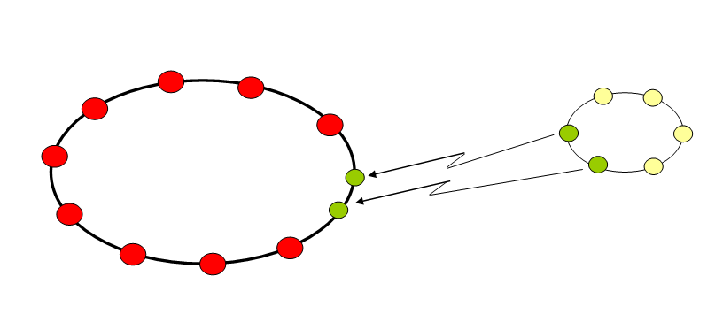
The finish line for an integrated real estate system
To set up a complex information data base for the integrated management of data related to the Italian real estate assets.
Building object
Objects history
Real estate market data
Owners history
Other
subjects
Street names
AII
Plans
External data
Incomes
Cartography
Registered
legal restrictions

Slide 4
The requirements for quality of real estate data
Digital data completeness
Digital data coherence with the original documents
Relationships between different archives (indices relationship)
Coherence between data recorded in each archive (attributes coherence)
Consistency of stored information with the existing situation on the territory
A better data quality will make it possible to provide new integrated search and view services and their spatial representation
This spatial representation (in the SIT) will in turn make possible:
Geographic surfing through stored data
A deeper territorial analysis of the real estate properties (fiscal policies, statistical surveys, assessment reviews)
A better control of the territory (real estate properties verifications)

Slide 5
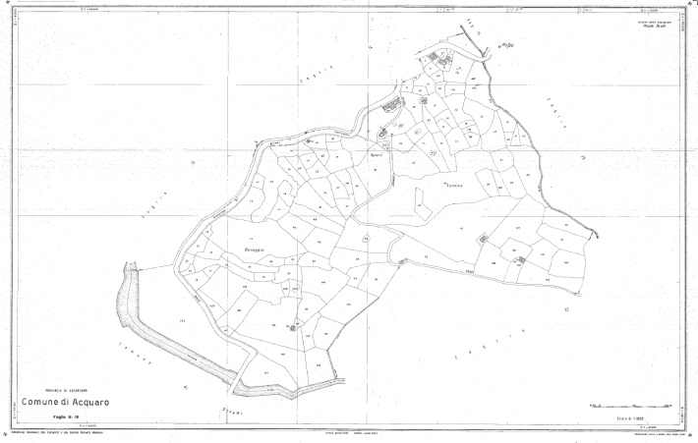
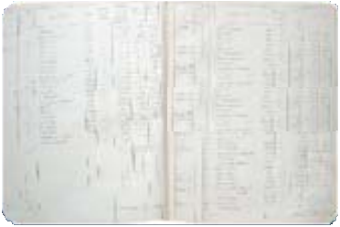
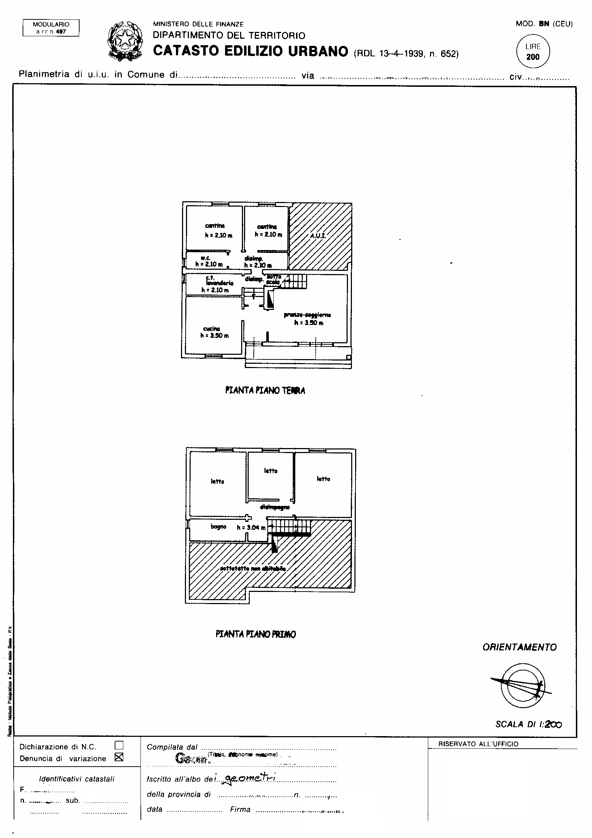
The development route of the Agency’s cadastral databases
Land
Cadastre
(LC)
80’s
Born Land Cadastre
Cartographic DB
Descriptive DB
Born BC
2006-2009
70’s
Automation LC
Automation BC
Autom. update LC
Pregeo
1886
Autom. update BC
Automation DB plans
1900
1988
2000
Autom. Mapping LC
Buildings
Cadastre
(BC)
Plans DB
Descriptive DB
1995-1999
80’s
1949
The DB completion
is in the final phase
1996

Slide 6
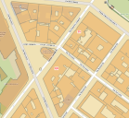
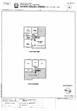
The databases completion and their correlation
Land Cadastre
Cartographic DB
Descriptive DB
Plans DB
Descriptive DB
Buildings Cadastre
DB completion : 1998-2015
Correlation between DB: 2004-2016

Slide 7
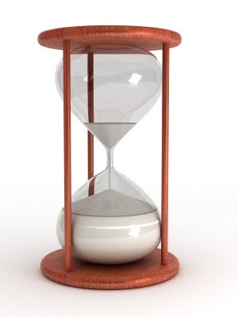
The cadastral databases monitoring and maintenance
To monitor the data quality level and assure at least the long-term stability of the maximum achieved levels, it is necessary to have a system to notice
existent inconsistencies;
misalignments of correlation indices.
This system, created very recently, is based on two “search engines” that cyclically control the four cadastral databases, updating:
the list of inconsistencies
the correlations table
and make possible their spatial representation.
The system will make it possible to remove both the anomalies reasons, through software interventions, and their effects, through periodical recovery actions.
Finally, it will be possible also to measure and map the level of one or more quality indices, through the aggregation of elementary data.
Land cadastre
cartographic
descriptive
plans
descriptive
Buildings cadastre

Slide 8
The cadastral databases monitoring and maintenance
Land cadastre
The list of inconsistencies makes it possible to find out the existing anomalies between the elements of the land and the buildings cadastre, from the point of view of a cadastral database compared with the content of the other databases.
The elements of the list are grouped in subsets according to their characteristics:
cartographic
descriptive
plans
descriptive
1° group → elements of the LC census database with anomalies in the BC census database or in the cartographic database
Buildings cadastre
2° group → elements of the cartographic database with anomalies in the LC or BC census databases
3° group → elements of the BC census database with anomalies in the LC census database or in the cartographic database
4° group → elements of the BC census database with anomalies in the plans database or in the same BC census database (i.e. address, house number, floor, area, class, etc…)

Slide 9
The cadastral databases monitoring and maintenance
Land cadastre
The correlations table includes the list of all the elements with anomalies in the «relations» between the LC and BC identifiers.
The abnormal elements (the parcels) are grouped in subsets according to their characteristics (non correlated elements, elements with multiple or wrong correlation).
cartographic
descriptive
plans
descriptive
Buildings cadastre
The rules used by search engines, after their implementation in the acceptance procedures for the cadastral updating documents (Pregeo and Docfa), will make it possible to identify inconsistent data (in case of declaration including wrong elements) or to recover them immediately after their input (in case of inconsistencies already existing in the cadastral archives).

Slide 10
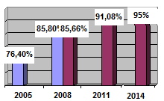
The cadastral databases monitoring and maintenance
The activities for recovering data quality have been carried out by the Agency staff through unusual resources, also starting up one of the first remote work experiences between local Offices of a public administration.
This remote work experience made it possible to redirect the progressively available resources to the activities up to Offices having a greater workload.
These activities mainly concerned
cartographic and census updating
updating of the holders
collection of urban real estate units plans
assessment of the area of urban real estate units
correlation between land and urban cadastre parcels
street names recovery and encoding
The mentioned recovery activity made it possible in about 10 years to increase of nearly 20 percentage points a reference index of data quality.
The current general index, as measure of cadastral databases completeness and consistency, is the result of several detailed indicators related to 5 typologies of data: cadastral identification number, owner data, valuation data, address and graphic data. It’s estimated about 95%.
estimated value

Slide 11
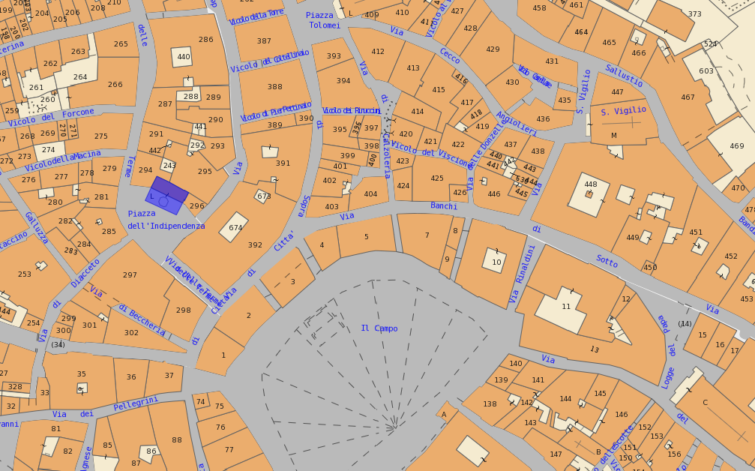
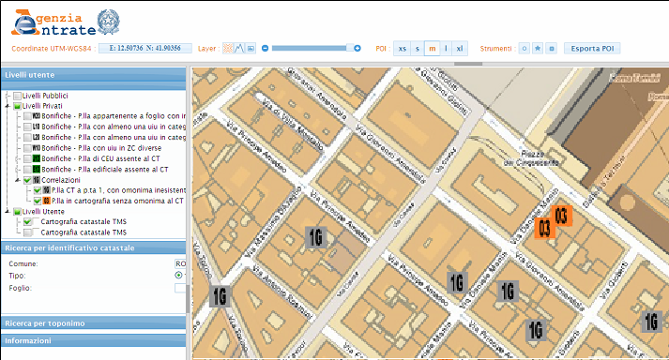
The cadastral databases monitoring and maintenance
Example of inconsistencies in correlations. In the next future the spatial representation will be carried out in the new Integrated Territorial System (SIT) based on a GIS logic.

Slide 12
MANY THANKS
FOR YOUR KIND ATTENTION

